Slide 1
Big Data Architecture and Governance Individual Project – Bellevue Hospital
SOUMAVO GURIA
NUID-001495565

Slide 2
Company Name: Bellevue Hospital
Industry: Healthcare
History/Background: Bellevue Hospital, founded on March 31, 1736, is the oldest public hospital in the United States. Located on First Avenue in the Kips Bay neighborhood of Manhattan, New York City, Bellevue Hospital is also home to FDNY EMS Station 08, formerly NYC EMS Station 13.
It handles nearly 460,000 non-ER outpatient clinic visits, nearly 106,000 emergency visits and some 30,000 inpatients each year. More than 80 percent of Bellevue's patients come from the city's medically underserved populations. The hospital currently occupies a 25-story patient care facility with an ICU, digital radiology communication and an outpatient facility. The hospital has an attending physician staff of 1,200 and an in-house staff of about 5,500.
Bellevue was renamed NYC Health + Hospitals/Bellevue in November 2015 as a reflection of its parent organization's rebranding.
In 2014 Bellevue was ranked 40th overall in the New York metro area and 29th in New York City by U.S. News and World Report.
Bellevue traces its origins to the city's first permanent almshouse a two-story brick building completed in 1736 on the city common now City Hall Park. In 1798, the city purchased Belle Vue farm, a property near the East River several miles north of the settled city, which had been used to quarantine the sick during a series of yellow fever outbreaks. When the grid system of streets was established in 1811, the survey had to take the hospital into account, and the placement of First Avenue on the grid is mainly due to the location of Bellevue. The hospital was formally named Bellevue Hospital in 1824.

Slide 3
Organization Issues
Project Name: TELMED – Telemedicine
Project Name: REQBSA – Requirement Based Staff Allocation
At Bellevue hospital since there is a large number of incoming patients on a daily basis, because of this the wait time in the queue for registration is longer. After this visiting the doctor and lot of paperwork results in wastage of lot of time.
The project, Telemedicine, can be extremely useful with the help of video conferences, smartphones, wireless devices and wearables. The term ‘Telemedicine’ refers to delivery of remote clinical services using technology.
With real time gathered from patients from wearables, doctors can use it for primary consultations, initial diagnosis and remote patient monitoring. Doctors can use telemedicine to provide personalized treatment plans and prevent hospitalization or re-admission. Healthcare data analytics can be linked to predictive analytics which will allow clinicians to predict acute medical events in advance and prevent deterioration of patient’s condition.
By keeping patients away from hospitals, telemedicine will help reducing cost, improve quality of service and reduce wastage of time. Telemedicine will also help in availability of care as patients’ state can be monitored and consulted anywhere and anytime.
This project is to tackle the problem which is often faced by shift managers of Bellevue Hospital since it handles a huge number of patients everyday. If you put on too many workers, you run the risk of having unnecessary labor costs add up. Too few workers, you can have poor customer service outcomes – which can be fatal for patients.
We can use data from a variety of sources to come up with hourly and daily basis prediction of patients present in hospital.
We can use past 5 years data set from hospital’s admission records and use Time-Series analysis techniques to find relevant pattern in admission rates. Then we can use machine learning to find the most accurate algorithm that can predict future admission trend.
Big data technology will help in gathering and processing such huge amount of data collected from databases of various department in hospital to forecast visit and admission rates for next 15 days. Extra staff can be drafted in when high numbers of visitors are expected. This will also help in cost management and optimal use of resources.

Slide 4
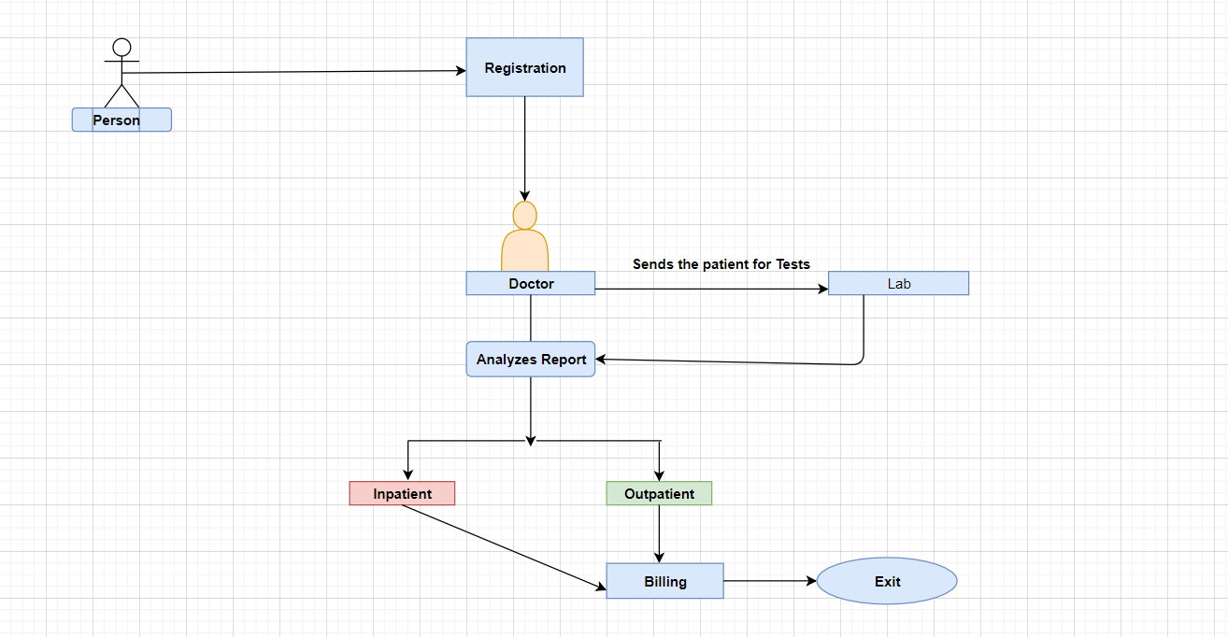
Project Name: TELMED – Telemedicine
Visio Diagram before implementation

Slide 5
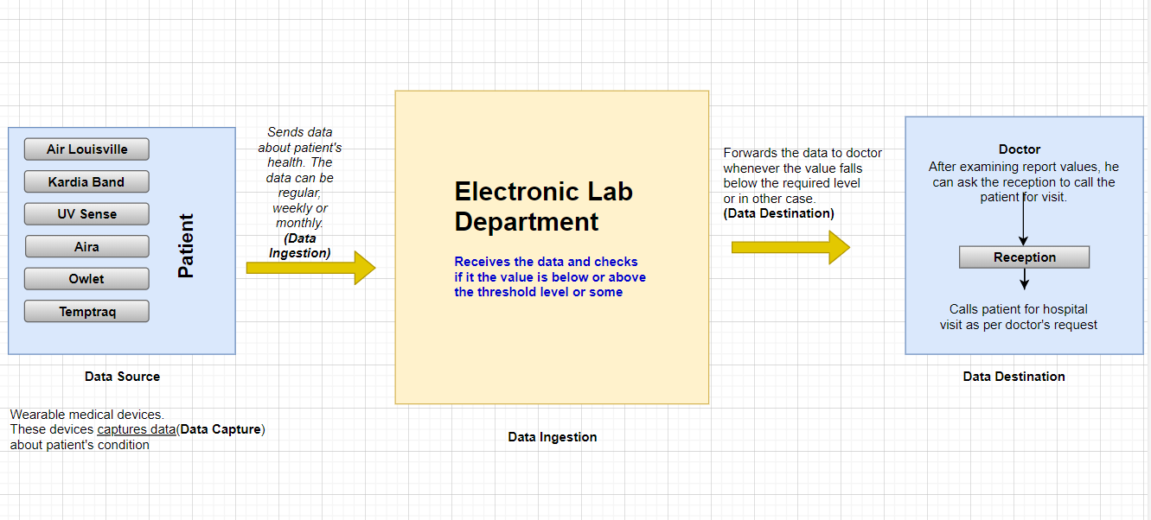
Visio Diagram after implementation

Slide 6
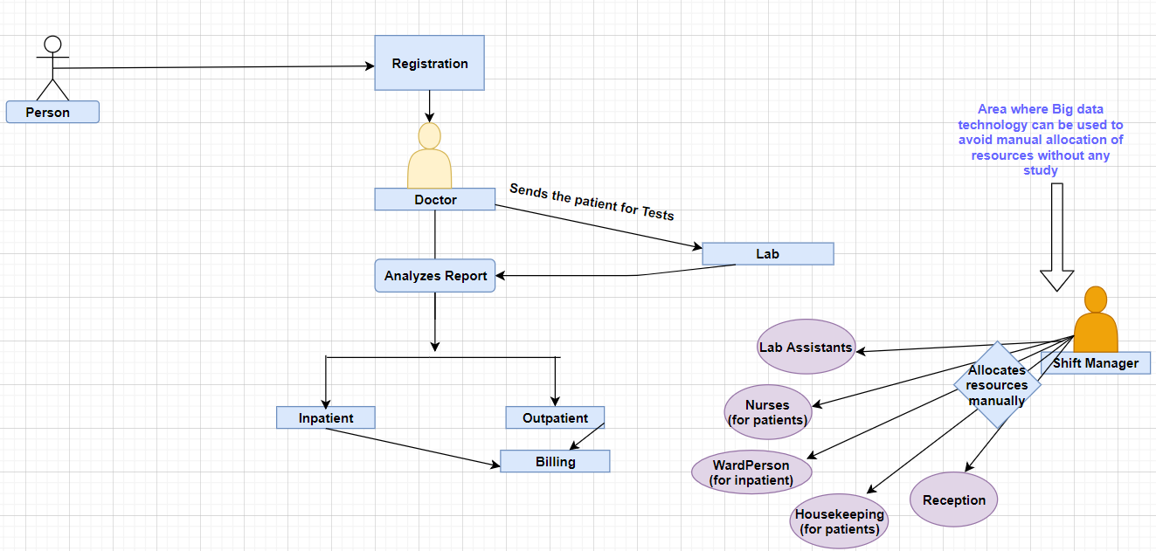
Project Name: REQBSA – Requirement Based Staff Allocation. Visio diagram before implementation

Slide 7
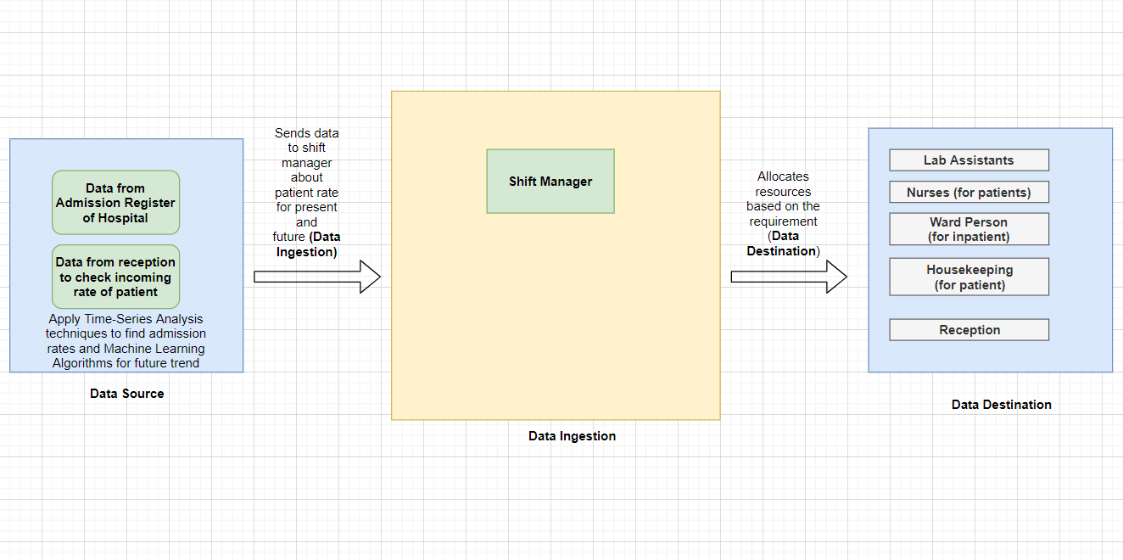
Visio Diagram after implementation

Slide 8
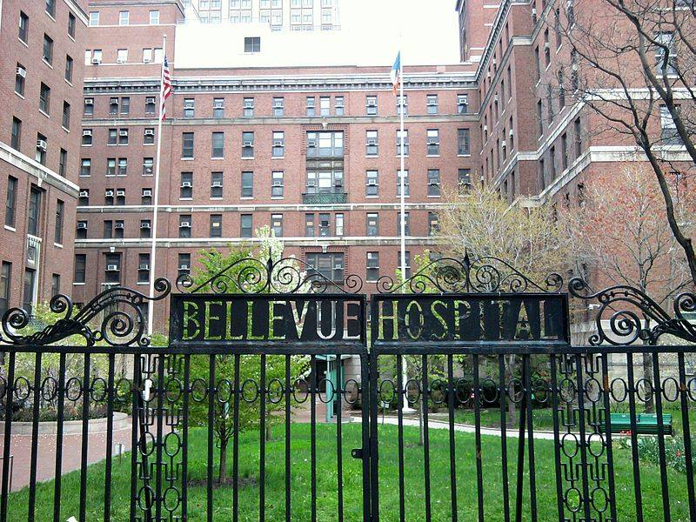
Main benefits are: >>Better healthcare methods and techniques. >>Improve in treatment process. >>Optimization of process will help in saving time and money. >>This will reduce waiting time of patient and avoid unnecessary paperwork. >>This will keep lot of people away from the hospital which will help in better hospital operation during peak hours. >>Patient’s can be monitored and treated from remote location.
Bellevue Hospital
Project: TELMED (Telemedicine)

Slide 9
Main benefits are: >>Use of resources wisely to save cost. >>Will make shift managers work easy while allocating resources >>Provide better services to patient, especially, during peak hours. >>This will reduce waiting time of patient and avoid unnecessary paperwork. >>Utilizing resources wisely will result in low cost for daily operational activities.
Bellevue Hospital
Project: REQBSA (Requirement Based Staff Allocation)

Slide 10
The primary reasons for selecting TELMED project are:
The project focuses on patients/people along with cost.
The project also looks for the convenience of people by reducing their frequent visit to the hospital.
The project reduces the waiting time of patient and avoid unnecessary paper works.
Patient’s health can be monitored 24*7 and they can consult doctor from anywhere. The doctor can also provide treatment remotely.
To wrap up, the three integral elements in this project are cost, time and people. The purpose of project is to save time and reduce cost and for convenience of the patient.

Slide 11
Comparison by Facts
Aspects | TELMED | REQBSA
OPS Expense | 293000 | 270000
ROI | 255000 | 153000
Resources Reduction | 25 | 50
Budget Allocation | 82000 | 47000
Impact | Patient | Staffs
Risk | Comparably low | Only 3rd Party Involved

Slide 12
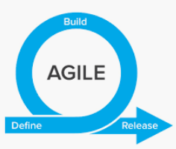

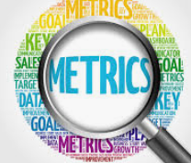
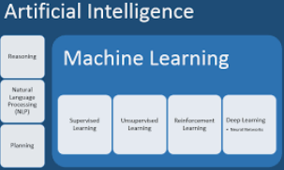


Functional Requirement
Agile Framework and methodologies will be followed for project development
Data is retrieved from wearables of patients and stored in Data repository system
All important metrics must be taken into consideration like Max Value/Threshold Value regarding patient’s health
Machine Learning and AI in the system should be able to detect the values and notify the lab technicians when there is aberration in value and predict future values
The doctor is responsible for providing treatment to patient in any location
The data can be used to visualize and find trends on the data from the repository system

Slide 13
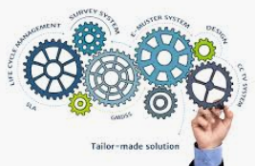



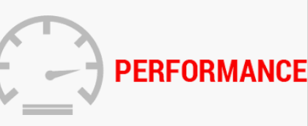
Non-Functional Requirement
The system should be able to compare the value received from wearables and compare with the predefined max/min/ideal values
The repository should be always up and running and the sensitive data received from the patient should be secure
The system should be reliable, efficient, reusable and must maintain integrity. The system should handle the data input flux and flow should be well-defined
Rigorous testing should be performed before receiving data from wearables of patients
The system must ensure optimal performance for Big data solution by considering the following
Performance on Data Acquisition
Performance for Storage
Performance for Data Processing

Slide 14
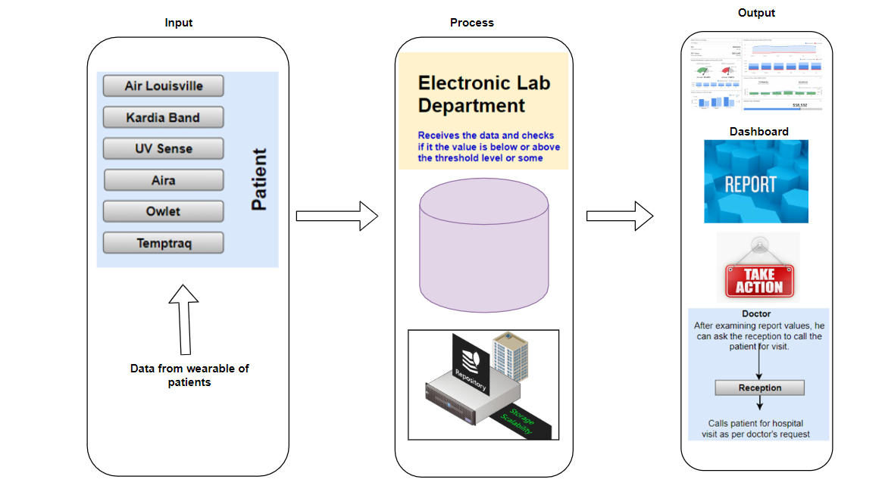
VISION DIAGRAM

Slide 15
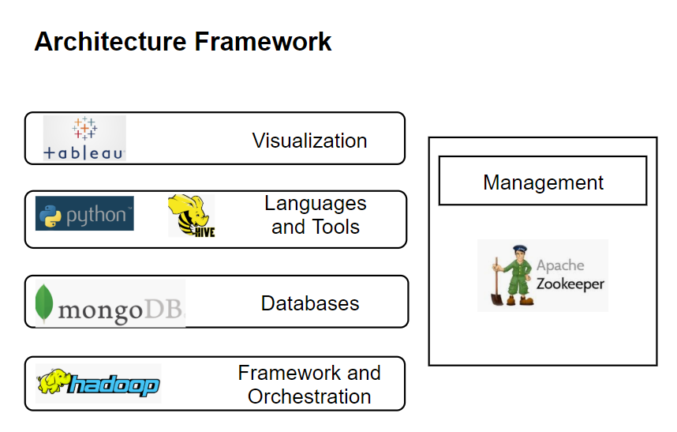

Slide 16
Strategy and Architecture
Data Visualization: Tableau
Tableau is a BI tool for visualizing and analyzing the data
We can create dashboards for analysis and can be shared across multiple platforms
It is highly scalable and can be used even there is change in the source without compromising on security, performance or the data integrity
It doesn’t need the data to be residing at one place, it can be stored in multiple place and the visualization works same as if it was stored at single place.
Languages and Tools : (Python and Hive)
The languages used in this project would be Apache Hive and the Python (Machine Learning)
Apache hive is highly scalable, can be used when the volume of the data grows without reduction of its performance and has more user defined interfaces to extend
As the project revolves around the analysis we will make use of Python for the machine learning by using the AI techniques TensorFlow etc. to predict various outcomes by playing with the data from repository system
Python has an easy implementation for OpenCV. Python is favorite for everyone is its powerful and easy implementation. For other languages, students and researchers need to get to know the language before getting into ML or AI with that language

Slide 17
MONGO DB
MongoDB stores data in flexible, JSON-like documents, meaning fields can vary from document to document and data structure can be changed over time
The data from wearables can be structured and unstructured type of data which is very diverse ranging
MongoDB is a distributed database at its core, so high availability, horizontal scaling, and geographic distribution are built in and easy to use
Its open source which makes the developing new interfaces quicker
HADOOP
The framework is secured and scalable and has the various data encryption as a add on
Its fast, scalable, flexible and resilient to failure
Bellevue hospital can make use of Hadoop to have access to various new sources of data and also operate on different types of data, whether they are structured or unstructured. This allows them to generate value from all of the data that can be accessed by them
Through the ability to store data of unlimited size (beyond petabytes) and variety (video, LIDAR, RADAR, sensor, etc.), the Hadoop Distributed File System (HDFS) provides a high-performance and cost-effective foundation for storing data associated with autonomous vehicle research.

Slide 18
APACHE ZOOKEEPER
Apache Zookeeper is a service used by a cluster (group of nodes) to coordinate between themselves and maintain shared data with robust synchronization techniques. Zookeeper is itself a distributed application providing services for writing a distributed application.
The performance of can be enhanced by adding more machine to it with minor changes in the configuration without any downtime.
The benefits of using Apache Zookeeper is fast, reliable, atomicity and ordered.
Zookeeper is very performing management tool and very reliable compared to the other MDM tools

Slide 19
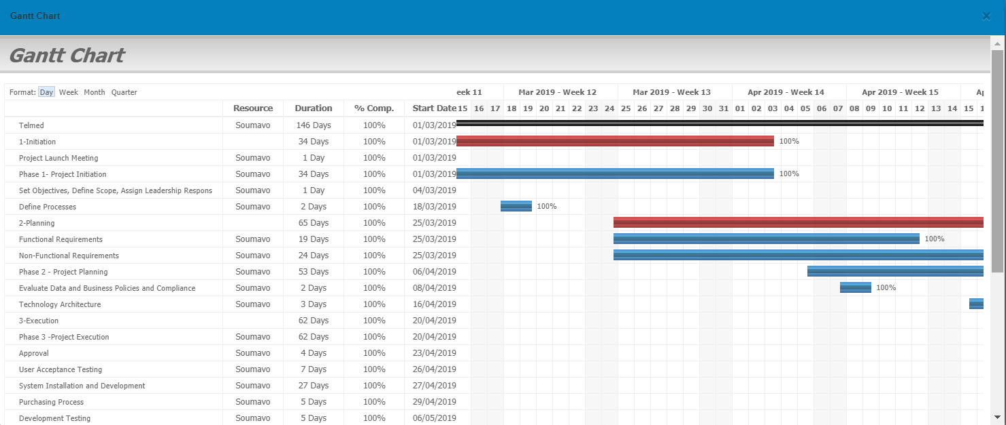
Project Plan
Category | Start date | End date
1 - Project Initiation | 3/1/2019 | 3/18/2019
2 - Planning | 3/25/2019 | 4/16/2019
3 - Execution | 4/20/2019 | 5/31/2019
4 - Controlling | 5/1/2019 | 5/30/2019
5 - Closing | 3/6/2019 | 5/7/2019

Slide 20
Project Plan
Heatmap | PLC Category | Order | Type | Milestone/Task Description | %Complete | Est Hours | Est HtC | Assigned To | Start Date | End Date | Status
Complete | 1-Initiation | 1 | Milestone | Phase 1- Project Initiation | 100.00% | 21 | 0 | Soumavo, Guria | 3/1/2019 | 4/3/2019 | Complete
Complete | 1-Initiation | 1 | Other | Define Processes | 100.00% | 4 | 0 | Soumavo, Guria | 3/18/2019 | 3/19/2019 | Complete
Complete | 1-Initiation | 2 | Other | Project Launch Meeting | 100.00% | 8 | 0 | Soumavo, Guria | 3/1/2019 | 3/1/2019 | Complete
Complete | 1-Initiation | 3 | Other | Set Objectives, Define Scope, Assign Leadership Responsibilities | 100.00% | 9 | 0 | Soumavo, Guria | 3/4/2019 | 3/4/2019 | Complete
Complete | 2-Planning | 1 | Milestone | Phase 2 - Project Planning | 100.00% | 40 | 0 | Soumavo, Guria | 4/6/2019 | 5/28/2019 | Complete
Complete | 2-Planning | 2 | Analysis | Non-Functional Requirements | 100.00% | 9 | 0 | Soumavo, Guria | 3/25/2019 | 4/17/2019 | Complete
Complete | 2-Planning | 2 | Analysis | Functional Requirements | 100.00% | 9 | 0 | Soumavo, Guria | 3/25/2019 | 4/12/2019 | Complete
Complete | 2-Planning | 2 | Analysis | Evaluate Data and Business Policies and Compliance | 100.00% | 8 | 0 | Soumavo, Guria | 4/8/2019 | 4/9/2019 | Complete
Complete | 2-Planning | 3 | Development | Technology Architecture | 100.00% | 14 | 0 | Soumavo, Guria | 4/16/2019 | 4/18/2019 | Complete
Complete | 3-Execution | 1 | Development | System Installation and Development | 100.00% | 70 | 0 | Soumavo, Guria | 4/27/2019 | 5/23/2019 | Complete
Complete | 3-Execution | 2 | Other | Purchasing Process | 100.00% | 12 | 0 | Soumavo, Guria | 4/29/2019 | 5/3/2019 | Complete
Complete | 3-Execution | 3 | Milestone | Phase 3 -Project Execution | 100.00% | 100 | 0 | Soumavo, Guria | 4/20/2019 | 6/20/2019 | Complete
Complete | 3-Execution | 4 | Analysis | Approval | 100.00% | 4 | 0 | Soumavo, Guria | 4/23/2019 | 4/26/2019 | Complete
Complete | 3-Execution | 5 | Systems | Development Testing | 100.00% | 15 | 0 | Soumavo, Guria | 5/6/2019 | 5/10/2019 | Complete
Complete | 3-Execution | 6 | QA | User Testing and Acceptance | 100.00% | 15 | 0 | Soumavo, Guria | 5/20/2019 | 5/30/2019 | Complete
Complete | 3-Execution | 6 | QA | User Acceptance Testing | 100.00% | 8 | 0 | Soumavo, Guria | 4/26/2019 | 5/2/2019 | Complete
Complete | 3-Execution | 7 | Next Steps | Conduct Training Sessions | 100.00% | 8 | 0 | Soumavo, Guria | 5/31/2019 | 6/4/2019 | Complete
Complete | 4-Controlling | 8 | Milestone | Project Control | 100.00% | 45 | 0 | Soumavo, Guria | 5/6/2019 | 5/24/2019 | Complete
Complete | 4-Controlling | 9 | Analysis | Evaluate Risks and Issues | 100.00% | 20 | 0 | Soumavo, Guria | 5/23/2019 | 5/30/2019 | Complete
Complete | 4-Controlling | 10 | Development | Project Management & Status Reporting | 100.00% | 40 | 0 | Soumavo, Guria | 5/1/2019 | 7/24/2019 | Complete
Complete | 4-Controlling | 11 | Next Steps | Generate Risk Management Plan | 100.00% | 10 | 0 | Soumavo, Guria | 5/30/2019 | 6/5/2019 | Complete
Complete | 5-Closing | 1 | Next Steps | Training | 100.00% | 40 | 0 | Soumavo, Guria | 6/3/2019 | 6/20/2019 | Complete
Complete | 5-Closing | 2 | Systems | Implementation | 100.00% | 16 | 0 | Soumavo, Guria | 6/14/2019 | 6/21/2019 | Complete
Complete | 5-Closing | 3 | Systems | Post Implementation Support | 100.00% | 20 | 0 | Soumavo, Guria | 6/24/2019 | 7/4/2019 | Complete
Complete | 5-Closing | 4 | Milestone | Closing | 100.00% | 18 | 0 | Soumavo, Guria | 7/5/2019 | 7/24/2019 | Complete

Slide 21
Issues and Risks
Issues
The issue related the project would be with the gathering of the data and the nature of the data. For the project to be successful there need to be all kinds of the data from wearables such as heart rate, pulse rate etc.
The AI model developed does not work accurately on different types of data received from various wearables
There may be changes in project execution due to frameworks and libraries being updated regularly. It may provide us with better patches to be used with our existing architecture
Risks
As the project completely dependent on the user data, there is chance of policy changes in the country on data which is being used
The system if hacked can cause fatal damage
Data loss due to power failure or natural disasters

Slide 22

Data Collection
Data will be collected from wearables of patients from anywhere and anytime
Airborne light detection and ranging (LiDAR) is a standard tool for collecting accurate data at a very high speed
These data have found use in many applications and several new applications are being discovered regularly
Data is collected from these sensors and a pipeline would be built to store the data in MongoDB

Slide 23

SECURITY
All the tools which we are using has their own security and these additional points are taken into consideration to enhance the security.
Encrypt all the data, so that upon loss of data will not impact the hospital
Access permissions for system data may only be changed by the system’s data administrator
Secure all in-network connected devices with device management policies
Continuous monitoring of data usage
Regular system backup to be performed and the backup copies needs to be stored in a secure location
Apply fine-grained access controls for people accessing patient data
Apply individual data ownership and control to tackle day to day issues

Slide 24
Scalability
Scalability refers to the capability of a system to handle a growing amount of work when processing power is expanded to accommodate growth. A system is said to be scalable if it can increase its workload and throughput when additional resources are added.
Scaling up or Vertical scaling is process in which you add new resources like memory or CPU to improve system performance. Scaling out or Horizontal scaling is the process of adding more hardware to a system.
There is an increase in number of data points – Scale Out
Increase in number of transactions – Scale Up
Increase in storage – Scale Out

Slide 25
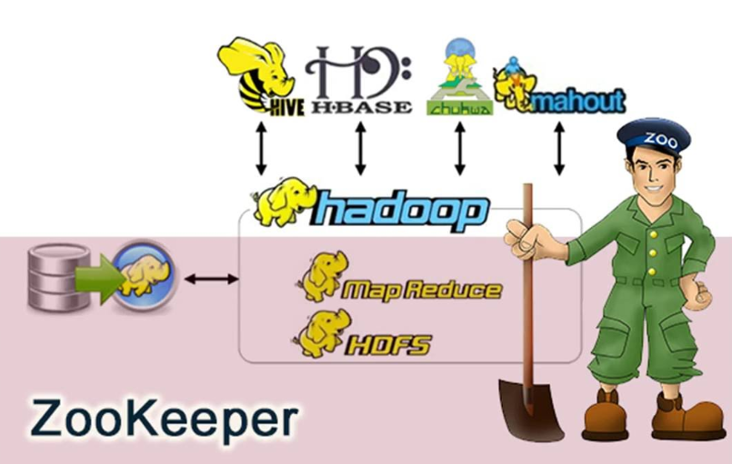
Management
Manageability is brought about by using Apache ZooKeeper
ZooKeeper is a centralized service for maintaining configuration information, naming, providing distributed synchronization, and providing group services
Apache ZooKeeper is an open source volunteer project under the Apache Software Foundation
Each time they are implemented there is a lot of work that goes into fixing the bugs and race conditions that are inevitable.

Slide 26
THANK YOU

